Slide 1
Position Analysis with CalLite
Kevin, Messele, En-Ching, Erik, Nazrul

Slide 2
Position Analysis with CalLite
Past
Observed Data
Future
Simulated/Forecasted Data
JUN
JUL
AUG
SEP
Oct
Nov
Dec
Jan
Feb
Mar
Oct
Nov
Dec
Jan
Feb
Mar
Oct
Nov
Dec
Jan
Feb
Mar

Slide 3
Position Analysis with CalLite
2013 WY
Simulated with Historical Data
2012 WY
Observed Data
Oct
Nov
Dec
Jan
Feb
Mar
JUN
JUL
AUG
SEP
1976
Oct
Nov
Dec
Jan
Feb
Mar
1977
Oct
Nov
Dec
Jan
Feb
Mar
1983

Slide 4
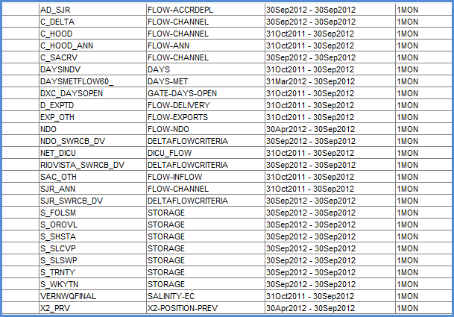
Step 1. Prepare initial data

Slide 5
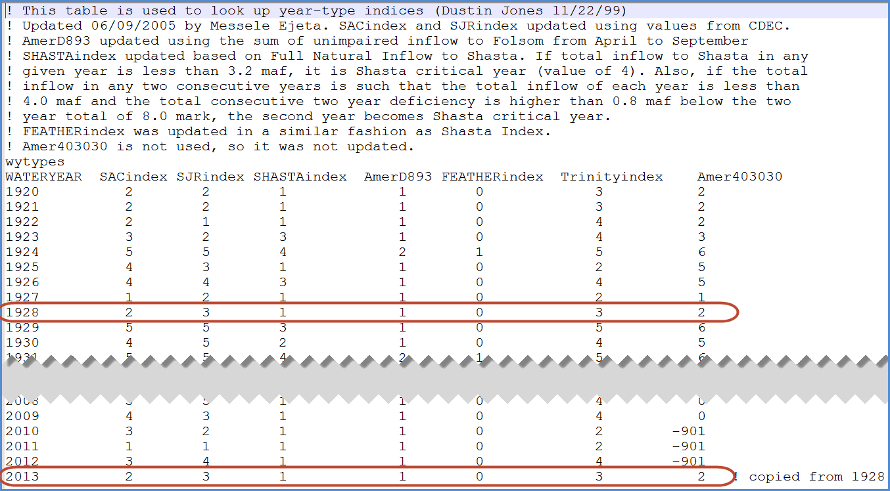
Step 2. Copy historical yearly tables to future

Slide 6
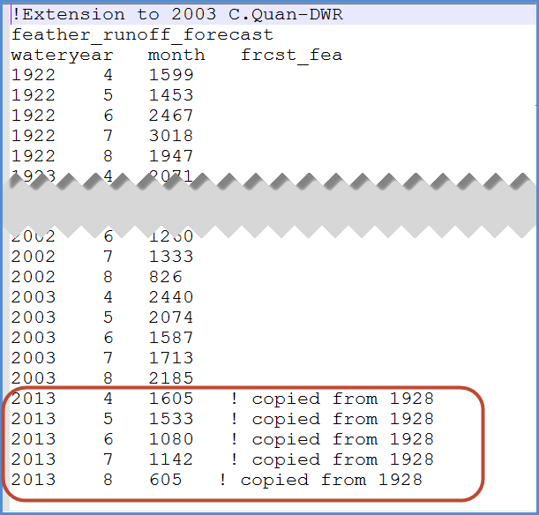
Step 3. Copy historical monthly tables to future

Slide 7
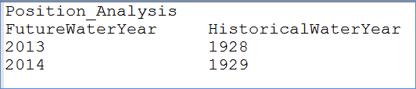
Step 4. Create lookup table to convert future WY to historical WY

Slide 8
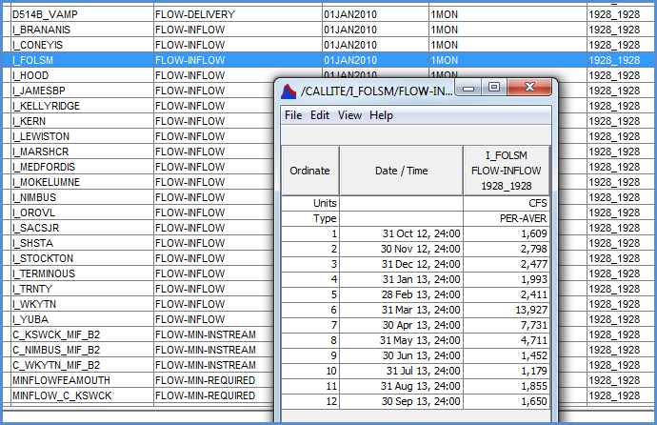
Step 5. Copy historical Svar data to future

Slide 9
Step 6. Prepare delivery request table

Slide 10
Step 1. Provide initial data for decision variables. See .\Run\DSS\CL_INIT_2012.dss
Step 2. Provide 2012 annual requests data in this table: \Run\Lookup\PA_Base_D1641_Existing\AnnualReqDel_swp.table
Step 3. Enter data in the following "User Input" section
Step 4. Open a command prompt and type "vscript example_positionAnalysis.py"
Step 5. A batch file named "CalLitePA_demo.bat" will be generated. Double click this batch file to run the project.

Slide 11
Position Analysis with CalLite
Past Months
Observed Data
Future Months
Simulated/Forecasted Data

Slide 12
Folsom lake storage (FOL)
Shasta lake storage (SHA)

Slide 13
TODO:
Automatic water year type generation - for forecasted data or non-historical data
Encapsulate D1485 lookup table related code - so D1485 tables will not be needed when D1485 option is off

